Slide 1

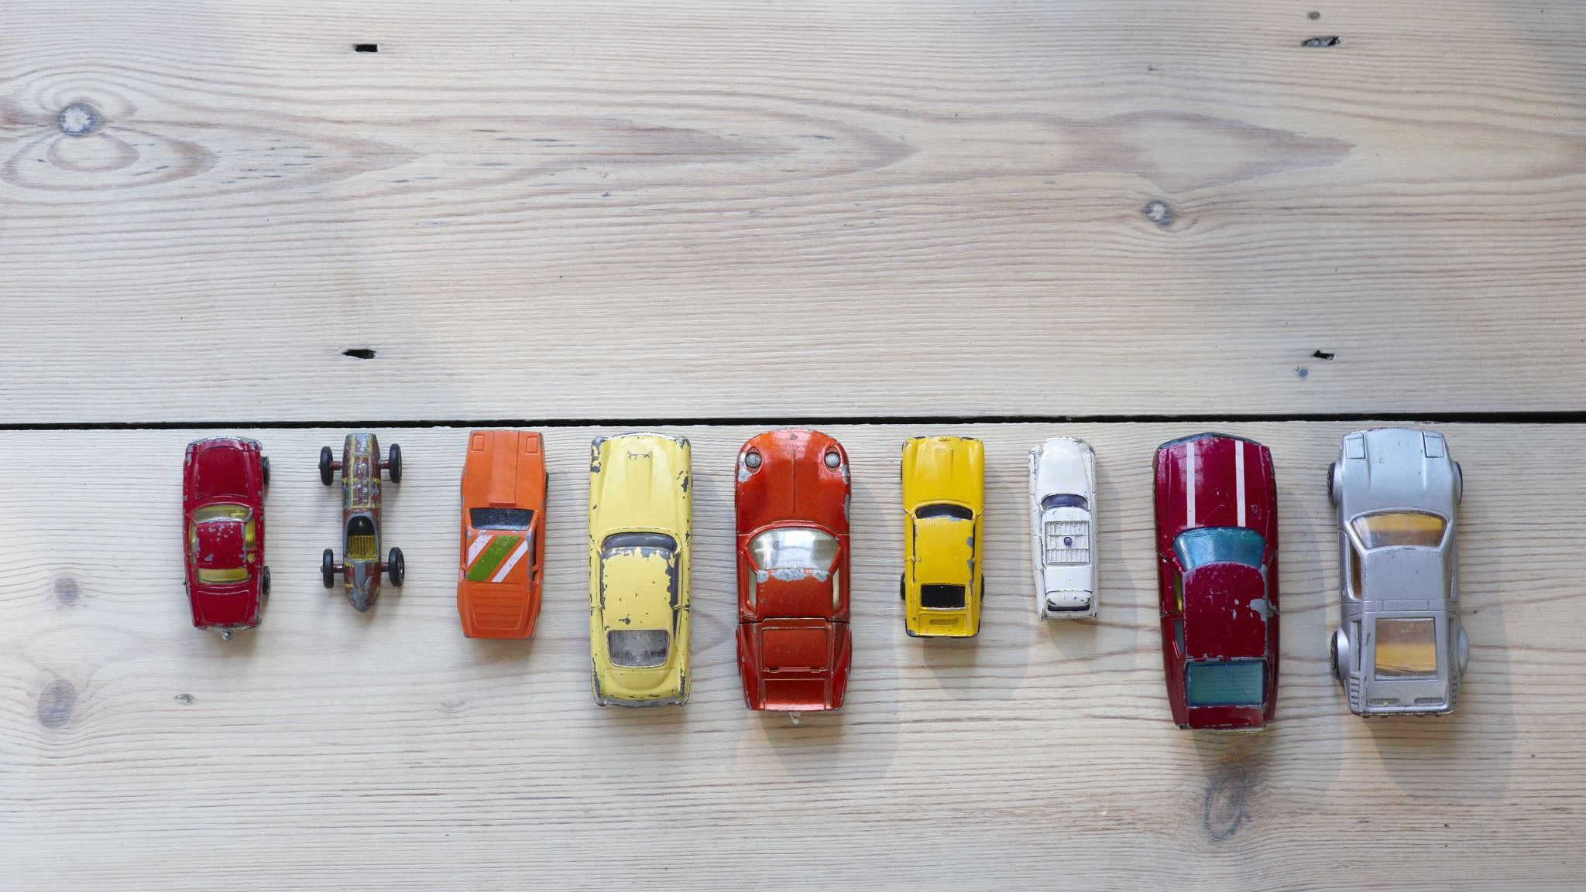
CAR PREDICTION USING MACHINE LEARNING TECHNIQUES
Sanjana Arkatala - 700687157
Divyanjali Gundala - 700743674
Chandra Mouli Krishna Vamsi Mendru - 700741069
Tasneem Shaik - 700741026

Slide 2
Group Members Information
Sanjana Arkatala - 700687157
Divyanjali Gundala - 700743674
Chandra Mouli Krishna Vamsi Mendru - 700741069
Tasneem Shaik - 700741026

Slide 3
Role/Responsibilities & Contribution
Detect and remove outliers in numerical variables- Divyanjali Gundala
Drop and fill missing values- Sanjala Arkatala
Feature Engineering- CM Krishna Vamsi Mendru
Multi Linear Regression -Tasneem shaik
Lasso Regression- Divyanjali Gundala
Support Vector Regression- Sanjana Arkatala
Random Forest Regression- CM Krishna Vamsi Mendru and Tasneem Shaik

Slide 4
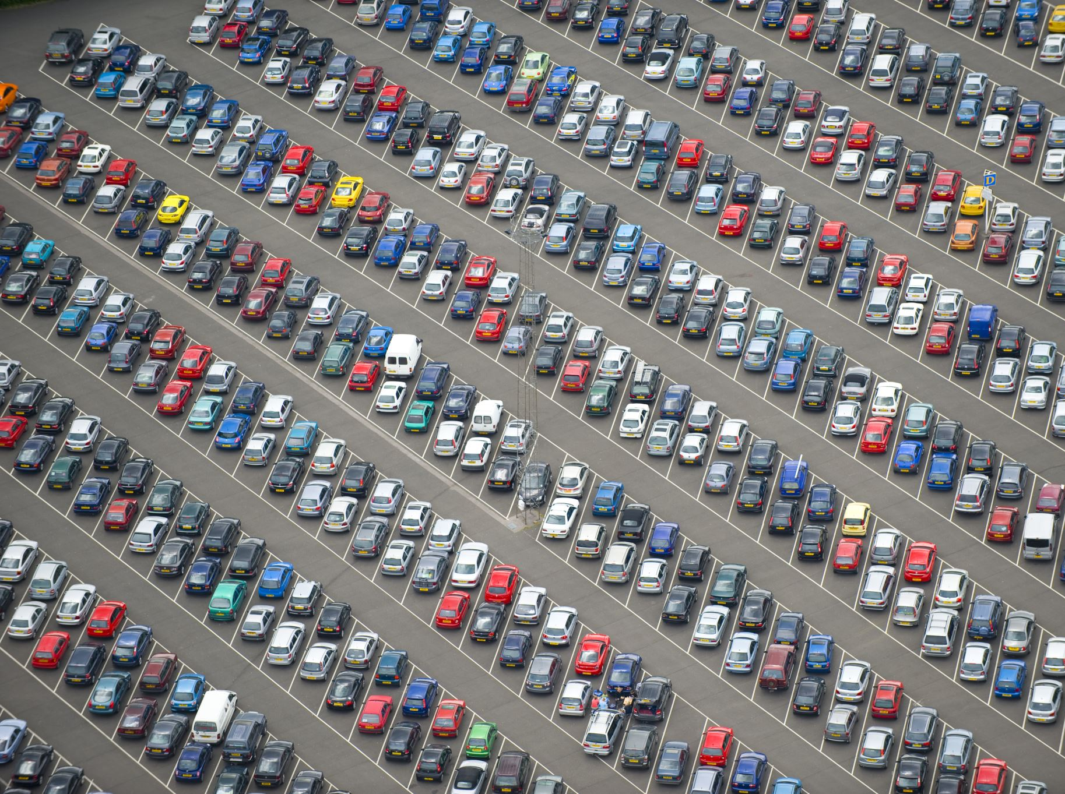

Motivation
In order to learn about cars, the most common method now is to read recommendations and posts made on online market websites.
The auto industry is becoming increasingly global and competitive annually.
As a result, in today's cutthroat auto industry, it is essential that fair prices be established for both consumers and producers
There is a lack of clarity regarding the appropriate purchase or selling price of automobiles, both among consumers and among manufacturers.

Slide 5


Objectives
Detect and remove outliers in numerical variables
Drop and fill missing values
Feature Engineering
Multi Linear Regression
Lasso Regression
Support Vector Regression
Random Forest Regression

Slide 6
Related Work
multivariate logistic regression, k-nearest neighbors, naive Bayes, and decision trees were used to forecast the cost of a used automobile in Mauritius. However, their results were not useful for forecasting because they saw fewer cars.
Noor and Jan used multiple linear regression to predict vehicle car price. They performed variable selection technique to find the most influencing variables then eliminate the rest. The data contain only selected variable that used to form the linear regression model. The result was impressive with R-square = 98%.

Slide 7
Problem
There is a lack of clarity regarding the appropriate purchase or selling price of automobiles, both among consumers and among manufacturers.
As a result, both consumers and businesses look to auto dealers, periodicals, and online resources for guidance.
This data, however, is time-consuming to compile and may cause market confusion. There are a lot of moving parts in the car market, thus trying to predict their costs is seen as difficult.
Car prices are affected not only by internal criteria like make, model, year, engine size, gas mileage, and so on, but also by a wide range of governmental levies and road conditions (for used car sales).
Therefore, the buying and selling of automobiles is a huge and diverse economic activity. E-commerce has made it simpler for buyers and sellers to transact business, and this includes the buying and selling of automobiles.

Slide 8

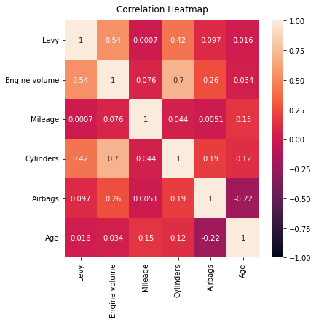
Correlation of the Features

Slide 9
Proposed Solution
We have conducted our analysis on different algorithms like
Multi Linear Regression
Lasso Regression
Support Vector Regression
Random Forest Regression
The Random forest regression low loss values so we porpose to use a RF model in finding car price.

Slide 10
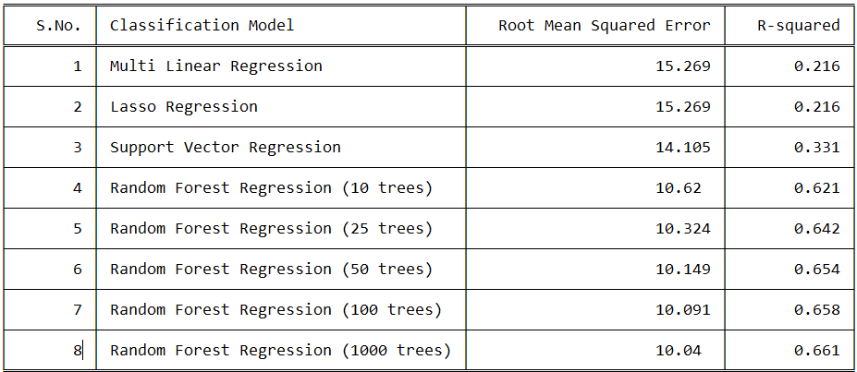
Results

Slide 11
References
[1] B. Kumar and P. Sarkar, “Prediction of future car forms based on historical trends,” Perspectives in Science, vol. 8, pp. 764 – 766, 2016, recent Trends in Engineering and Material Sciences.
[2] S. Lessmann and S. Vo, “Car resale price forecasting: The impact of regression method, private information, and heterogeneity on forecast accuracy,” International Journal of Forecasting, vol. 33, no. 4, pp. 864 – 877, 2017.
[3] J.-D. Wu, C.-C. Hsu, and H.-C. Chen, “An expert system of price forecasting for used cars using adaptive neuro-fuzzy inference,” Expert Systems with Applications, vol. 36, no. 4, pp. 7809 – 7817, 2009.
[4] N. Pal, P. Arora, D. Sundararaman, P. Kohli, and S. Sumanth Palakurthy, “How much is my car worth? A methodology for predicting used cars prices using Random Forest,” arXiv e-prints, p. arXiv:1711.06970, Nov 2017.

Slide 12

Thank You

